Slide 1
Final Presentation
Team RED

Slide 2
Commands and Result
Master:
sbt “run NUMBER_OF_WORKERS”
Worker:
sbt “run MASTER_IP:PORT –I INPUT_DIR1 INPUT_DIR2 .. –O OUTPUT_DIR
Results
Finished with two workers(~1 min) and Small/Big datasets
Manually checked result with tiny test, not with Small/Big datasets
Internal merging with Small/Big/Large datasets. Cross-check with distinct implementations

Slide 3

Analysis & Why project failed
Send every single records
Protobuf design or too much Futures
No head chef
Underestimated heap size challenge

Slide 4
Tournament Tree
update(force = false)
Node
.value
2
Tree[A <: Ordered[A]]
var value
def update(Boolean)
Include compile time
Large: ~ 300 sec
Big: ~ 27 sec
Small: ~ 10 sec
update value
Node
.value
Node
.value
2
3
Leaf
.value
Fruit
.value
Fruit
.value
Fruit
.value
2
update value
4

Slide 5
개발 방식
각자 기능을 하나씩 맡아 완성하는 대로 남은 기능을 하나씩 새로 맡는 방식
카카오톡으로 이야기하여 새로운 사항이 있을 때마다 논의
이후 본격적인 개발을 할 때는 직접 모여서 새로운 사항이나 변경점이 있을 때마다 곧바로 이야기해 나중에 일어날 후환을 없애려 노력함
각 기능을 독립적으로 개발했으므로 git merge에서 conflict를 줄이기 위해 노력함
함수 안과 밖을 최대한 구분해 지역 변수로 해결하여 함수를 분리할 수 있도록 함
몇몇 불변값은 미리 Constant 파일에 선언하여 실수의 여지를 최소화함
전역 변수를 사용할 때는 assert를 활용해 의도하지 않은 함수간 간섭을 체크함
자주 사용되는 기능은 Utils에 함수로 미리 구현해 오류의 여지를 최소화함

Slide 6
전체 구조
Project Codes
Common
Core
Network
Main
Utils
Message
State
Constant
Data Structures
TournamentTree
Master
Worker
NetworkClient
NetworkServer
Prelude
Interlude
Postlude
gPRC protobufs
* Data Structures: Block, Key, Record, Table

Slide 7
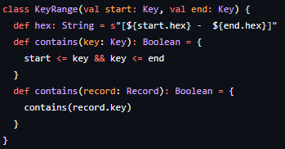
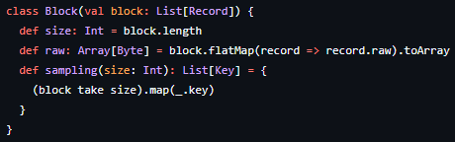
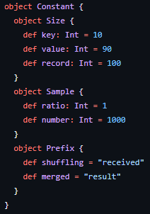

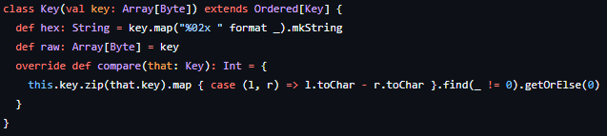
Class Design

Slide 8
Master
Worker
Worker
EstablishRequest
Establishment Interaction
EstablishResponse
SampleRequest
Sampling Interaction
(stream) SampleResponse
PartitionRequest
Partitioning Interaction
PartitionResponse
Master
Worker
Worker

Slide 9
Master
Worker
Worker
ShuffleRunRequest
ShuffleExchangeRequest
Shuffling Interaction
(stream) ShuffleExchangeResponse
ShuffleRunResponse
MergeRequest
Merging Interaction
MergeResponse
Master
Worker
Worker

Slide 10
Master
MakingPartition
MasterSending
SampleRequest
MasterSending
ShuffleRequest
MasterSending
MergeRequest
MasterSending
PartitionRequest
MasterPending
SampleResponse
MasterPending
ShuffleResponse
MasterPending
MergeResponse
Master
Initial
Master
Finished
MasterPendingPartitionResponse
Master
Connection
Established
Finish Sorting
MasterReceived
SampleResponse
Failure
MasterReceived
ShuffleResponse
Failure
MasterReceived
MergeResponse
Failure
Connection
Establishing
MasterReceived
PartitionResponse
Failure
MasterReceived
SampleResponse
MasterReceived
ShuffleResponse
MasterReceived
MergeResponse
MasterReceived
PartitionResponse
Sampling
Partitioning
Shuffling
Merging

Slide 11
WorkerPending
ShuffleRequest
WorkerPending
MergeRequest
WorkerPending
SampleRequest
WorkerPending
PartitionRequest
WorkerReceived
ShuffleRequest
WorkerReceived
MergeRequest
WorkerReceived
PartitionRequest
WorkerReceived
SampleRequest
Worker
WaitingAllData
Received
Worker
MergingData
Worker
PartitioningData
Worker
Initial
WorkerSending
SampleResponse
Worker
ReceivedAllData
Worker
MergingComplete
Worker
Finished
WorkerSending
PartitionResponse
Worker
Connection
Established
Finish Sorting
WorkerSending
ShuffleResponse
WorkerSending
MergeResponse
WorkerSending
SampleResponseFailure
WorkerSending
PartitionResponse
Failure
Connection
Establishing
WorkerSending
ShuffleResponse
Failure
WorkerSending
MergeResponse
Failure
WorkerSent
PartitionResponse
WorkerSent
SampleResponse
WorkerSent
ShuffleResponse
WorkerSent
MergeResponse
Sampling
Partitioning
Shuffling
Merging

